Slide 1
Sunnybrook Neuroimaging Summer School 2025
fMRI Module
Tutorial #2:
Task-Based &
Resting State fMRI Analysis
Emma Pineau

Slide 2
Tutorial Overview
Overview of Generalized Linear Modeling (GLM)
GLM Walkthrough in AFNI
How to interpret Statistical Parametric Maps (SPMs) from GLM
Identifying brain networks from resting state data using Independent Component Analysis (ICA)
Other considerations for resting state analysis

Slide 3
Part I: Generalized Linear Modeling
MATH 😷

Slide 4
Review of Task Based MRI
Want to know:
Which areas of the brain shown increased BOLD signal in response to the task?
How strong is that response?

Slide 5
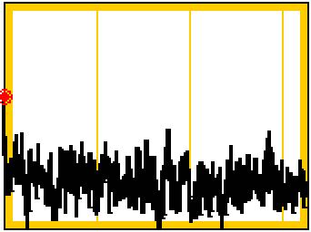
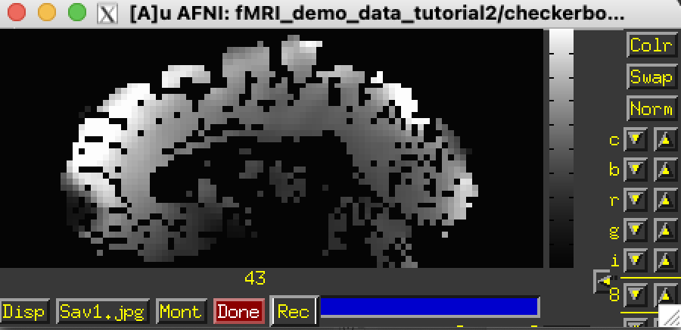
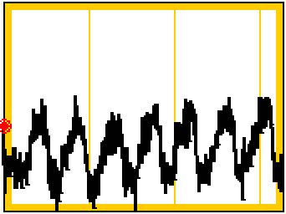
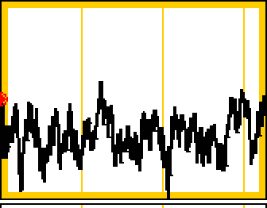
The Structure of fMRI Signal
Checkerboard ON

Slide 6
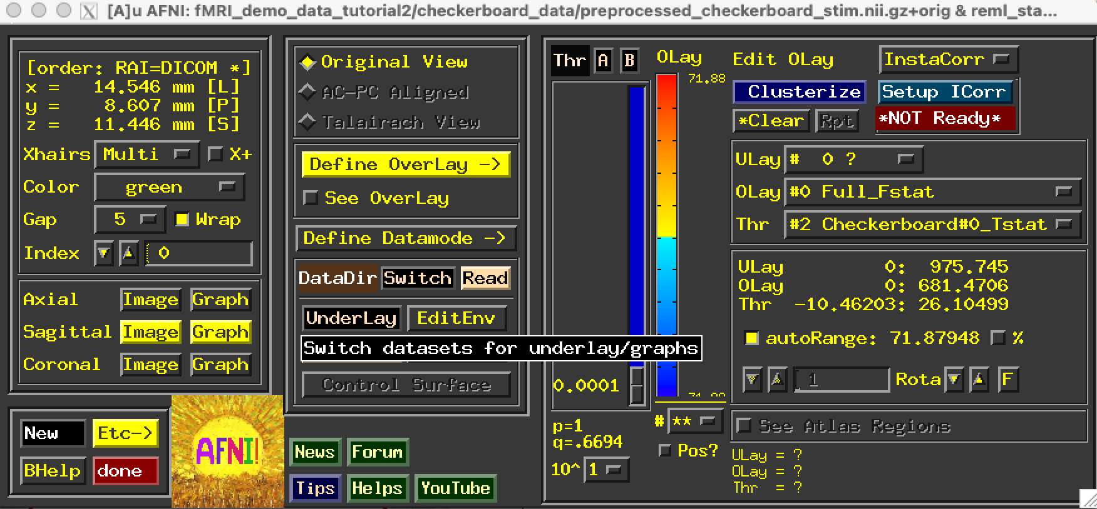
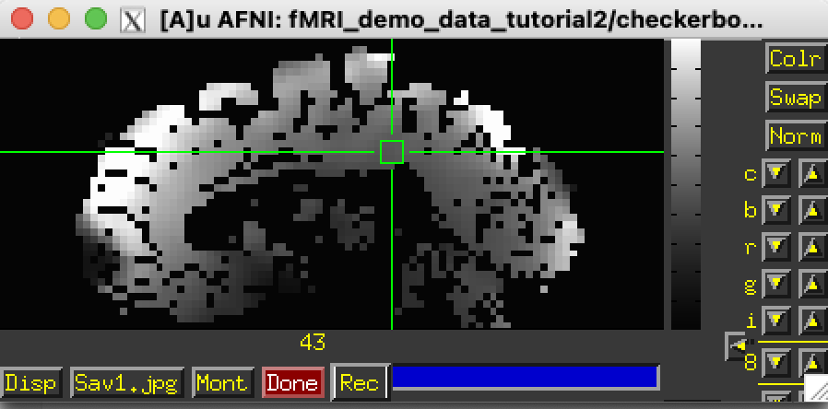
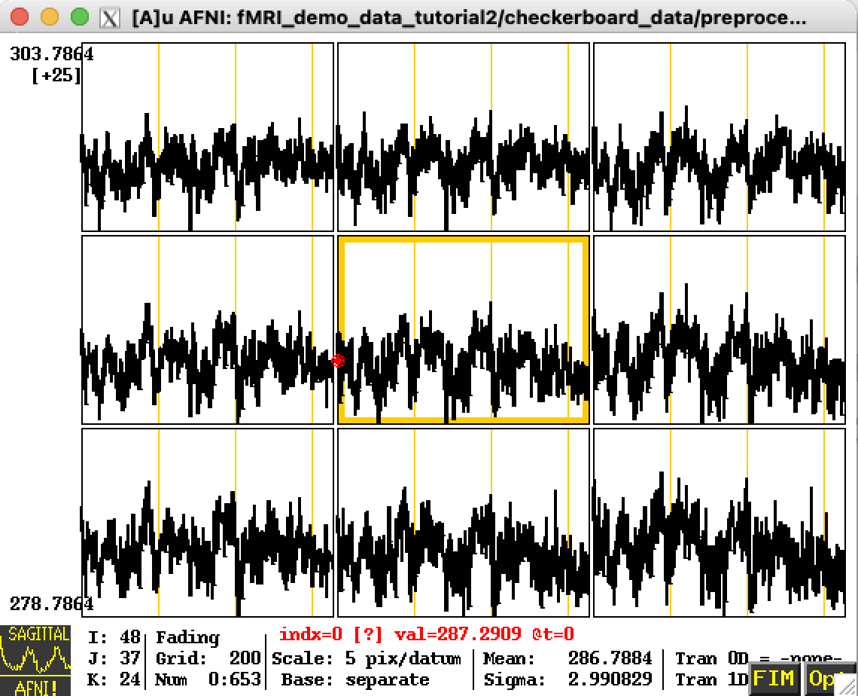
DEMO: Use AFNI to Look at Preprocessed Voxel-wise Timeseries
Click to display graph near to image plane options
Move crosshairs to show timeseries from a 3x3 array of voxels

Slide 7
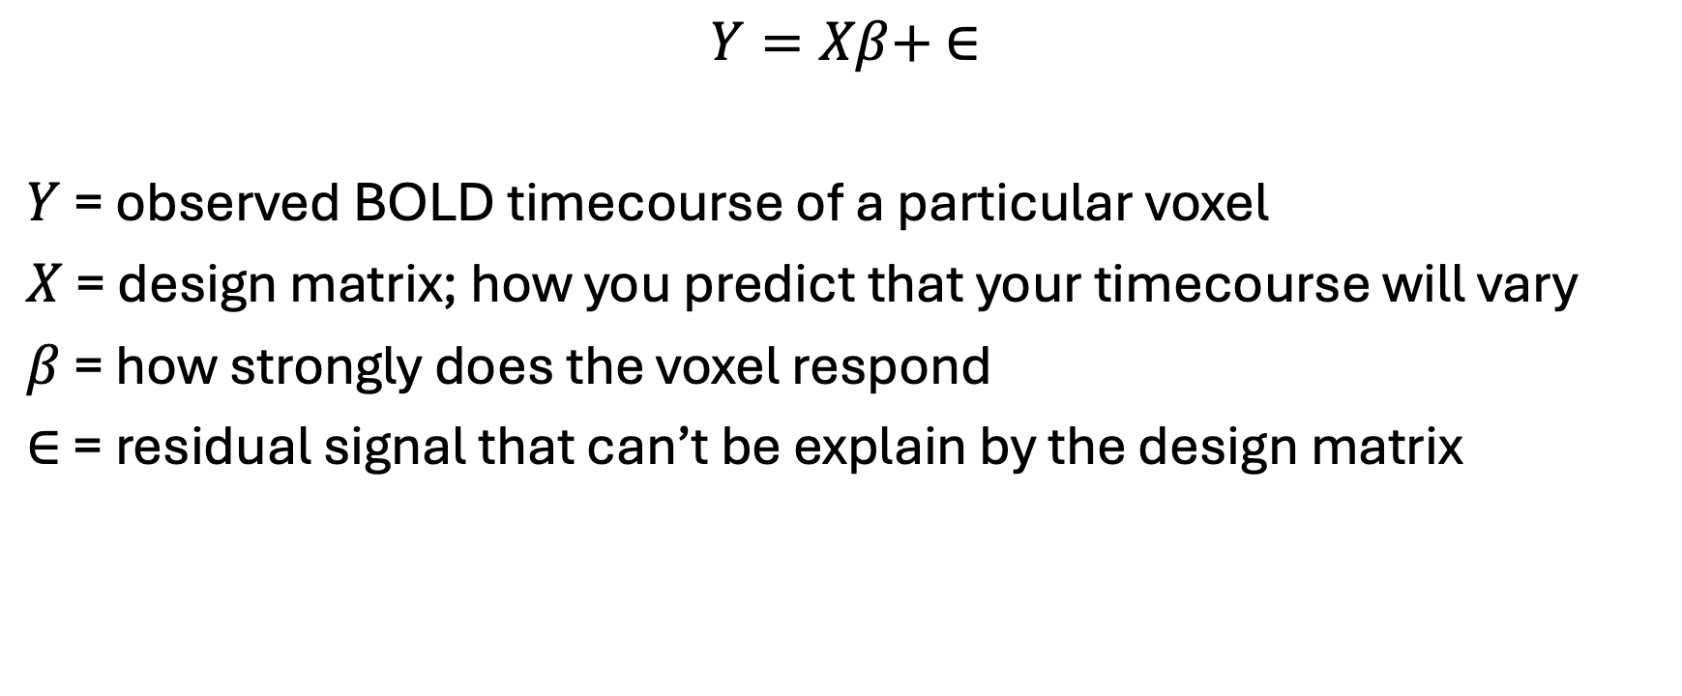
General Linear Model
$Y=Xβ+ ∈$
$Y$ = observed BOLD timecourse of a particular voxel
$X$ = design matrix; how you predict that your timecourse will vary
$β$ = how strongly does the voxel respond
$∈$ = residual signal that can’t be explain by the design matrix

Slide 8
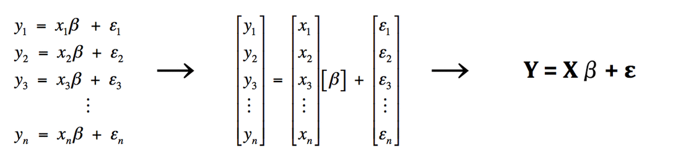

General Linear Model
$Y=Xβ+ ∈$
For all image voxels:
https://mriquestions.com/general-linear-model.html

Slide 9
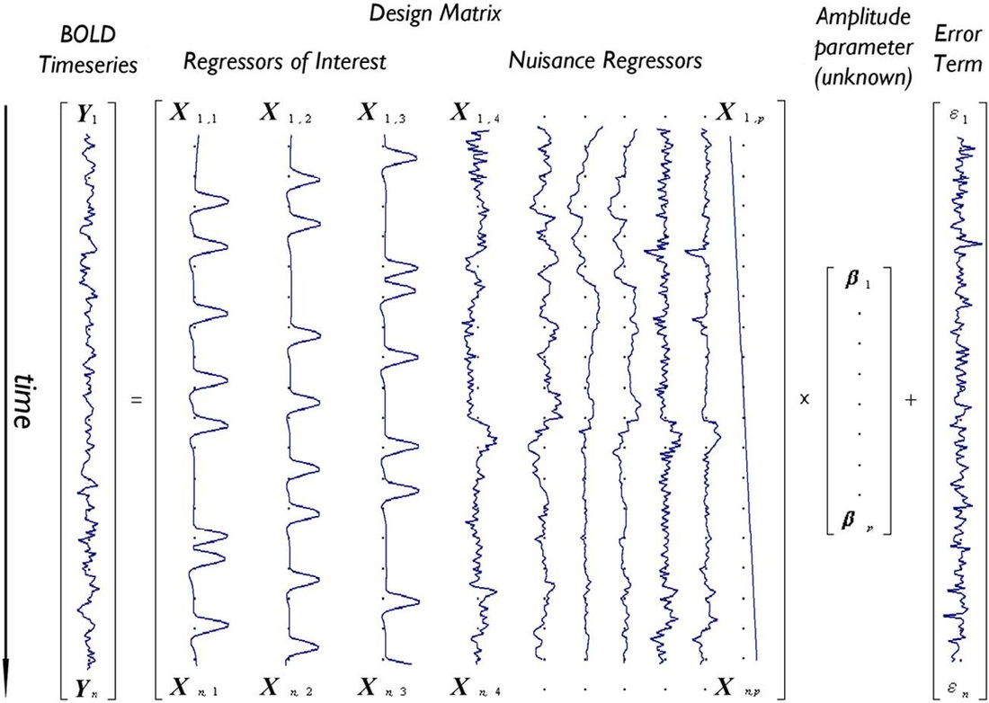
General Linear Model
https://mriquestions.com/general-linear-model.html

Slide 10
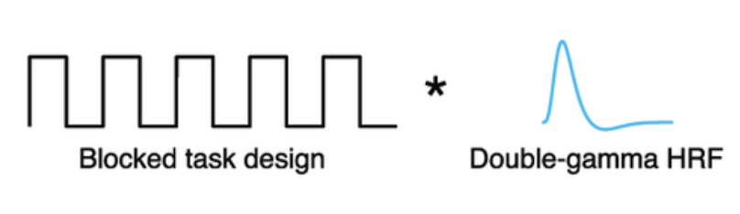
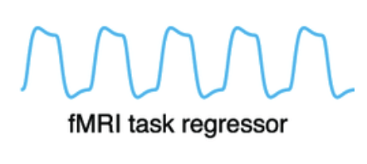
General Linear Model
Slow responding Haemodynamic Response Function (HRF) “smooths” expected signal response to blocked task design
=
https://mriquestions.com/general-linear-model.html
Lan et al., Neuroimage, 2020.

Slide 11
Model Outputs:
For each voxel we get:
1. Coefficients (β)
-how strongly does the signal change in response to the modeled stimulus
2. Residuals (ϵ)
-the part of the timecourse not explained by the model
3. Statistics (e.g., t-stats)
-is the estimated effect (β) reliably different from zero?
-computed as the coefficient divided by the standard error

Slide 12
Part II: DEMO - GLM Walkthrough
This tutorial is primarily based in AFNI’s command line tools

Slide 13
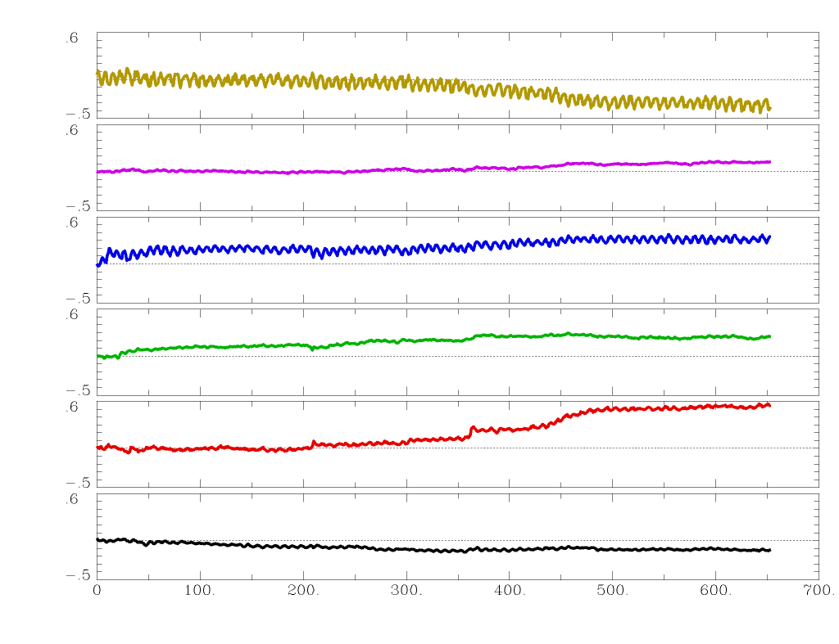
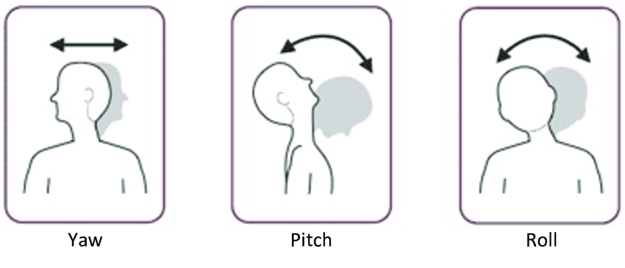
Step 0: Pre-Analysis Checklist
In folder checkerboard_stim:
1. Preprocessed fMRI dataset
2. .json file with scan acquisition metadata
3. Estimated motion regressors
(view this with 1dplot motion_params.1D)
4. Binary mask of grey matter
y
x
z
yaw
pitch
roll
Alghowinem, 2015
Notes:
In BIDS fMRI, the .json sidecar files store the acquisition metadata (e.g., TR, TE, flip angle, slice timing, phase encoding direction) needed to interpret the raw NIfTI data.

Slide 14
Step 1: Look at the Preprocessed fMRI Data
This is a 3d+time dataset
It has shape [x,y,z,t]
You can print the header using
3dinfo preprocessed_checkerboard_stim.nii.gz

Slide 15
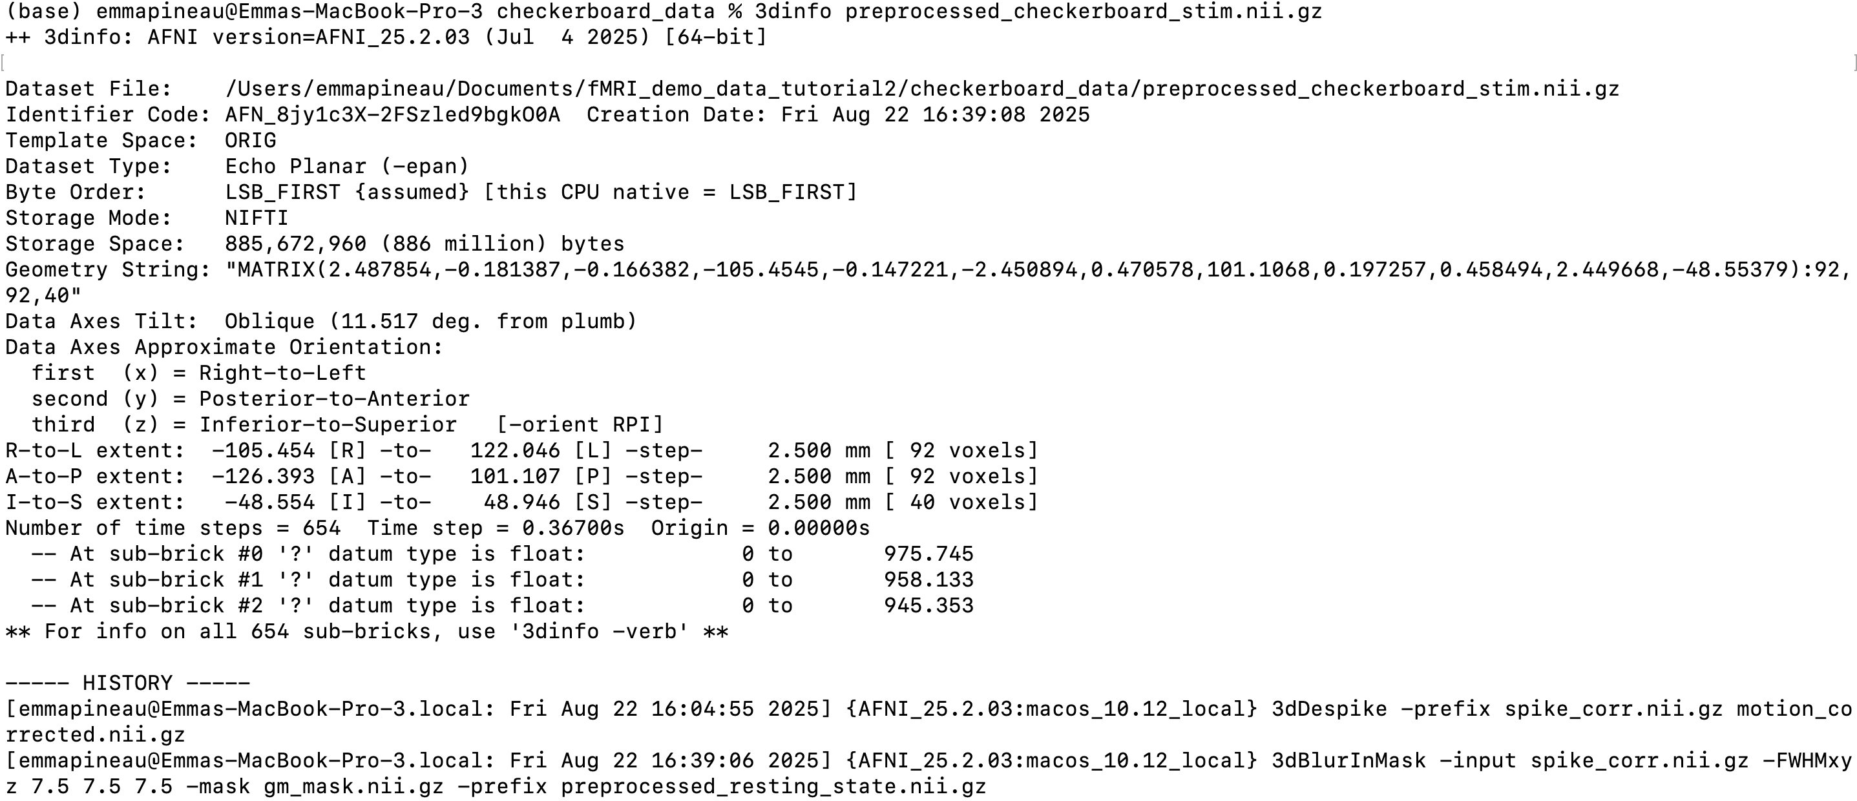
Step 1: Look at the Preprocessed fMRI Data
Imaging matrix dimensions and voxel sizes
AFNI stores command history too!

Slide 16
Step 1: Look at the Preprocessed fMRI Data
This is a 3d+time dataset
It has shape [x,y,z,t]
You can print the header using
3dinfo preprocessed_checkerboard_stim.nii.gz
You can print the acquisition metadata using
cat sub-06_task-checker_bold.json

Slide 17
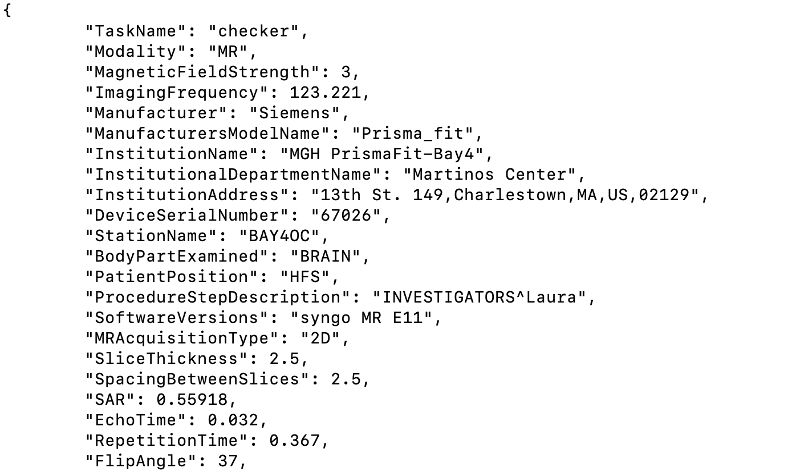
Step 1: Look at the Preprocessed fMRI Data
Scanner specs
Very high temporal resolution!

Slide 18
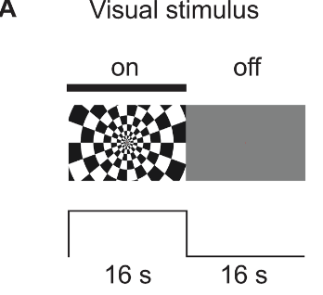
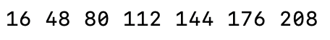
Step 2: Define Stimulus Timing File
Create .1D file with nano stim_timing.1D
Input the start times of all stim blocks, in seconds, relative to the start of the functional scan
From the paper where this dataset originates, we know that the stimulus is a flashing visual checkerboard with 16s ON/OFF cycle starting with an OFF
Figure 1A:
Williams et al., PLOS Biology, 2023
Separate each onset time by a single space

Slide 19
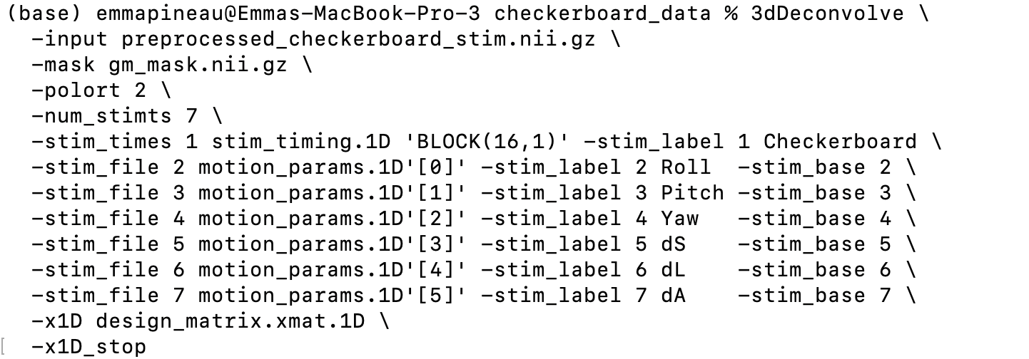
Step 3: Use 3dDeconvolve to Create a Design Matrix
Estimates quadratic drift term

Slide 20
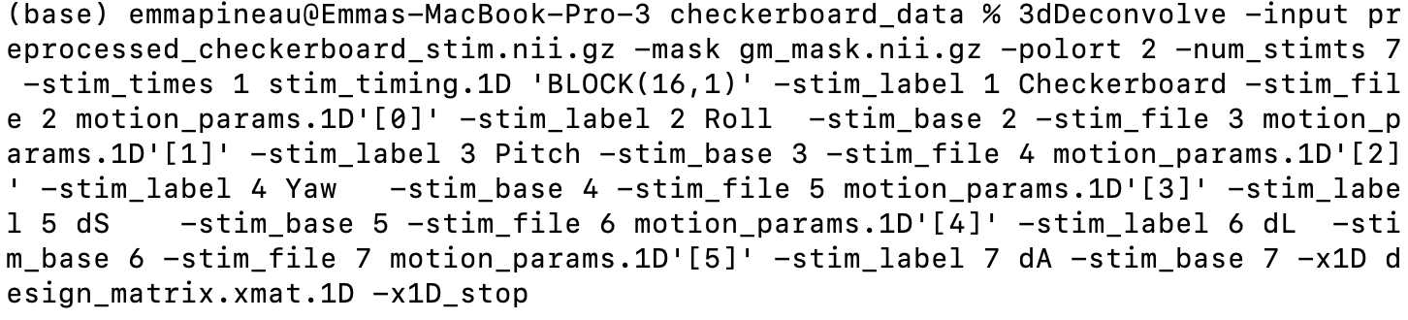
Step 3: Use 3dDeconvolve to Create a Design Matrix
An easier way to write the command so you don’t have to worry about slashes and spaces!

Slide 21
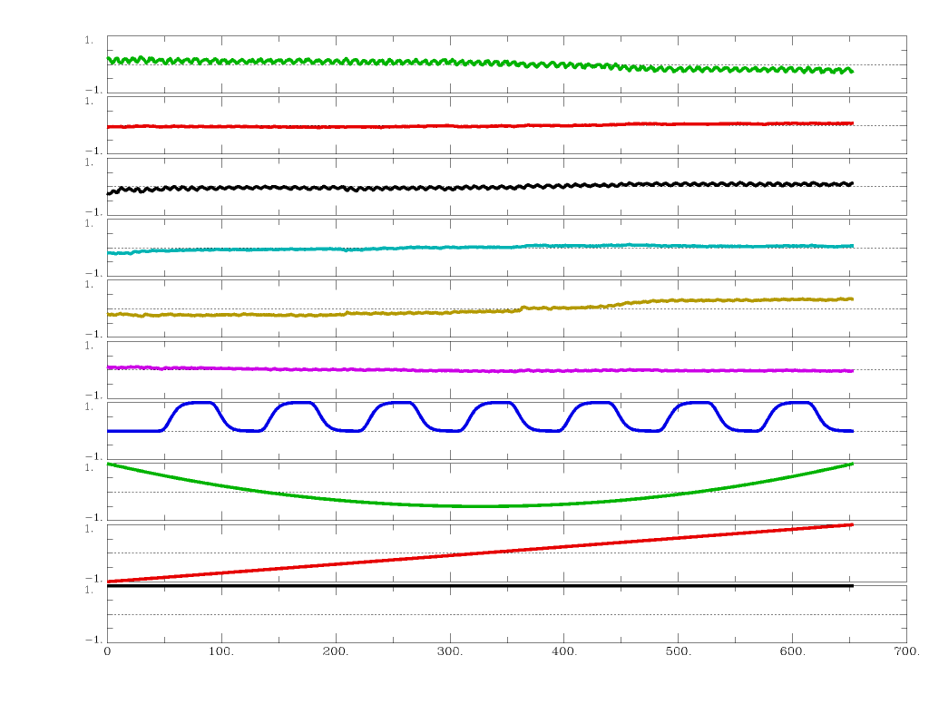
Step 3: Use 3dDeconvolve to Create a Design Matrix
1dplot design_matrix.xmat.1D
TIP:
Best to keep the model relatively simple as too many model functions decreases your sensitivity!
Motion Parameters
Block design convolved with HRF
Quadratic Drift Terms

Slide 22
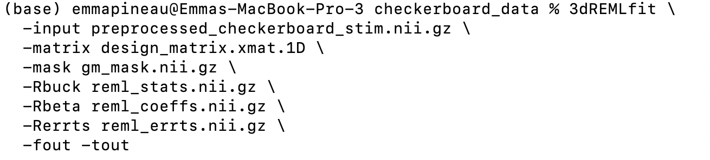
Step 4: Use 3dREMLfit to Estimate Statistics
Restricted-Maximum-Likelihood: form of Generalized Least Squares Regression analysis
Estimates t-statistics, fitting coefficients and model residuals

Slide 23
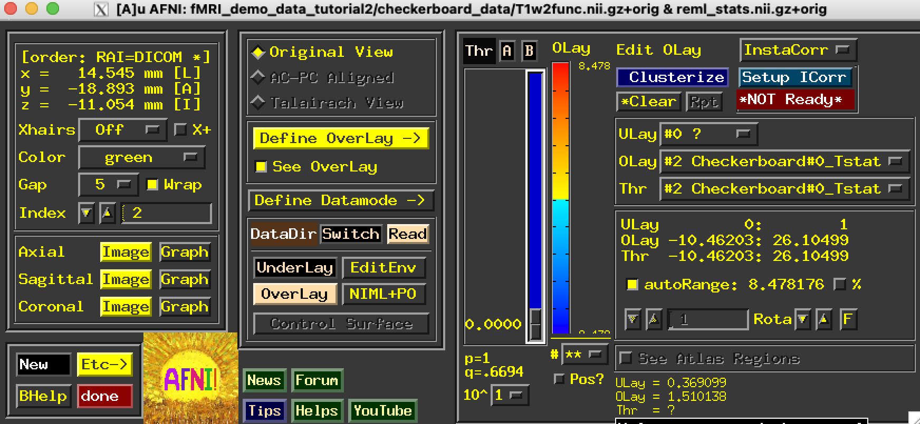
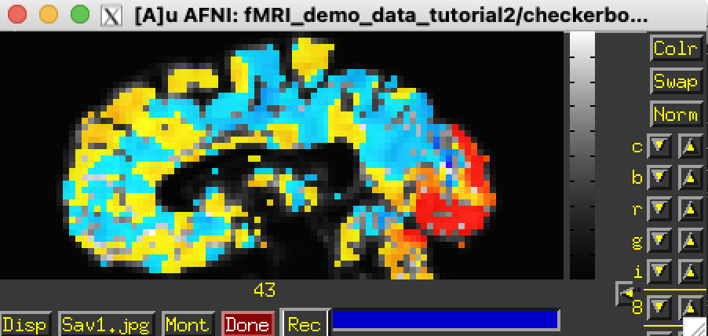
Step 4: Use 3dREMLfit to Estimate Statistics
Enter afni in a terminal to open the GUI
Set overlay to reml_stat.nii.gz and choose T-stat in Define Overlay panel
Congratulations, you’ve generated a Statistical Parametric Map!

Slide 24
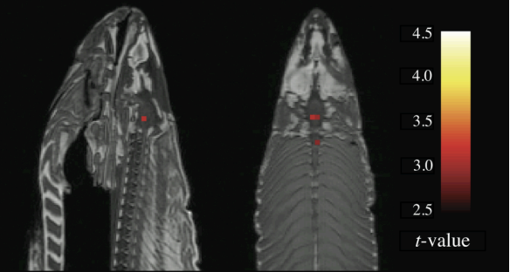
Step 4: Use 3dREMLfit to Estimate Statistics
This is an SPM
This is also an SPM
Bennet, HBM, 2009
How do we make sure we aren’t just detecting false positives?

Slide 25
Part III: DEMO - Interpreting Statistical Parametric Maps
And we will also get to familiarize ourselves with AFNI’s GUI!
+ some more math 😷

Slide 26
Uncorrected SPMs
Range of voxelwise t-statistics in our dataset
Colourmap range auto-selected to maximize contrast but you can change it
Corresponding p value to threshold value
Threshold slider of smallest |t| shown

Slide 27
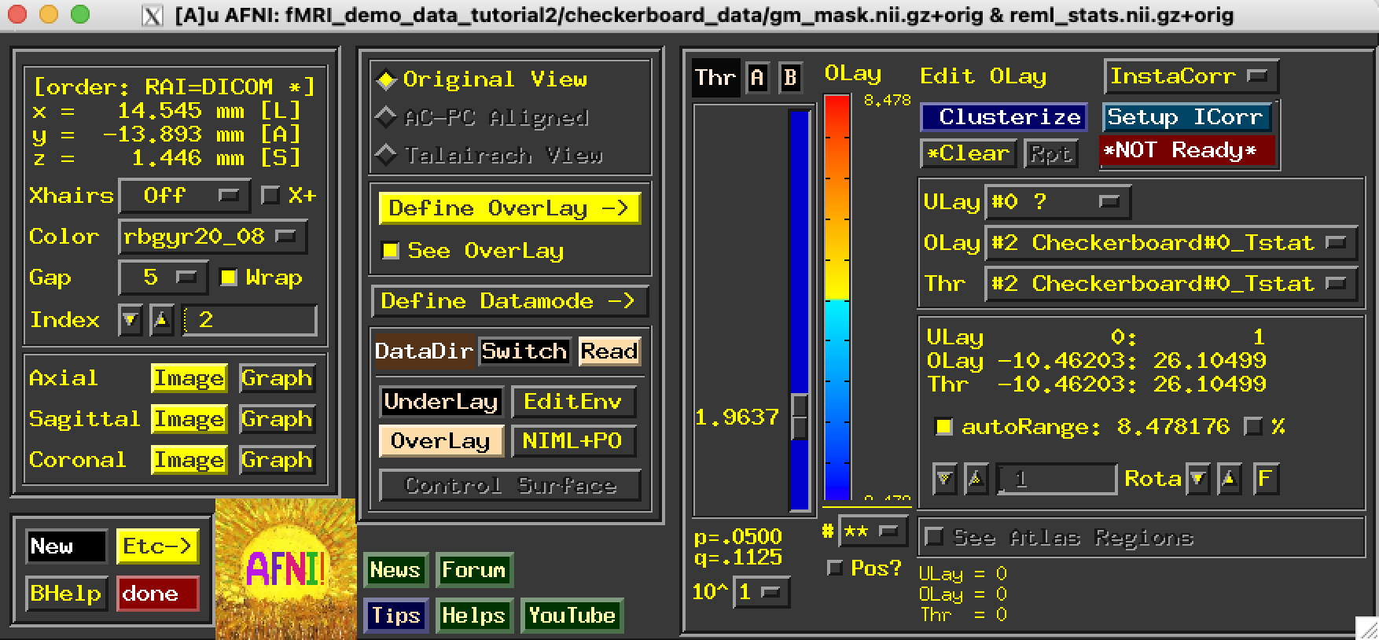
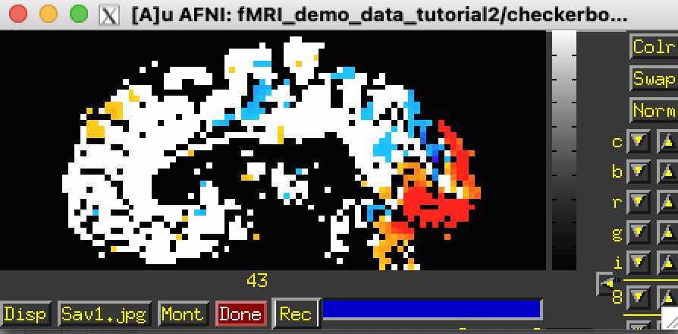
IDEA 1: Threshold by P-Value
Can change any of the thresholds by clicking here

Slide 28
IDEA 1: Threshold by P-Value
This image is 92 x 92 x 40 = 338560 voxels
If we accept p < 0.05 as our threshold, this still means 16928 voxels could be deemed active by chance alone.
16928 false positives!

Slide 29
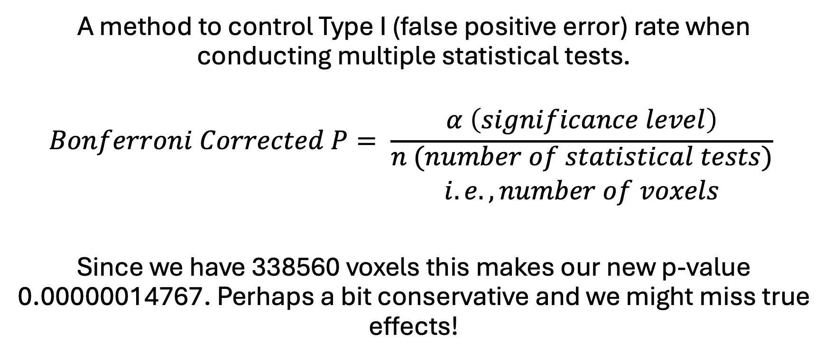
IDEA 2: Bonferroni Correction
A method to control Type I (false positive error) rate when conducting multiple statistical tests.
$$Bonferroni Corrected P= \frac{α \left(significance level\right)}{\begin{aligned}n (number of statistical tests) \\ i.e., number of voxels\end{aligned}}$$
Since we have 338560 voxels this makes our new p-value 0.00000014767. Perhaps a bit conservative and we might miss true effects!

Slide 30
IDEA 3: False Discovery Rate
Asks how many of our discoveries are we willing to be false positives?
Different to accept that 5% of activated voxels will be false positive rather than 5% of all brain voxels will be false positives
Less conservative than Bonferroni so less likely to miss true effect!

Slide 31
IDEA 3: False Discovery Rate
Order and assign rank to individual p-values for your different tests (i.e., different voxels)
Calculate critical value, i is the rank, m is the number of tests and Q is the FDR (i.e., 0.05)
Find the largest p-value where p < (i/m)Q and set that as your new threshold
NOTE: that there might be some smaller (higher rank) p values that don’t satisfy p < (i/m)Q that are still significant for being below threshold

Slide 32
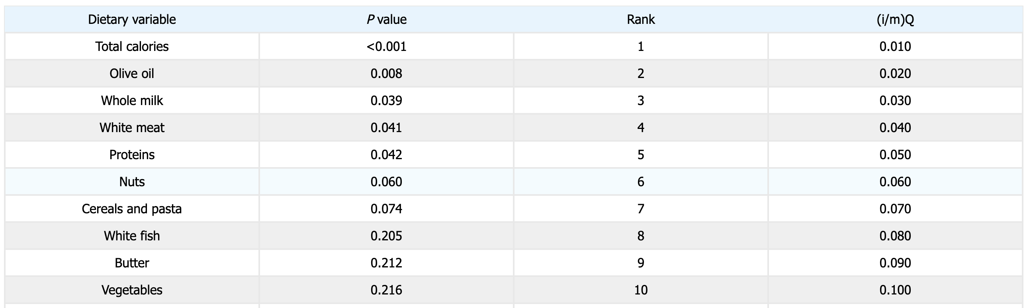
IDEA 3: False Discovery Rate
https://stats.libretexts.org/Bookshelves/Applied_Statistics/Biological_Statistics_%28McDonald%29/06%3A_Multiple_Tests/6.01%3A_Multiple_Comparisons and Garcia-Arenzana et al., 2014.
In this example, proteins have p < (i/m)Q and thus the new p-value threshold is 0.042. More stringent than p = 0.05 but less conservative than Bonferroni Correction.

Slide 33
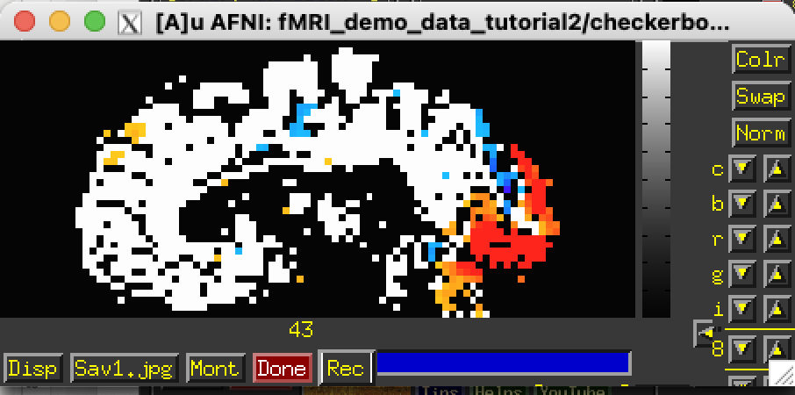
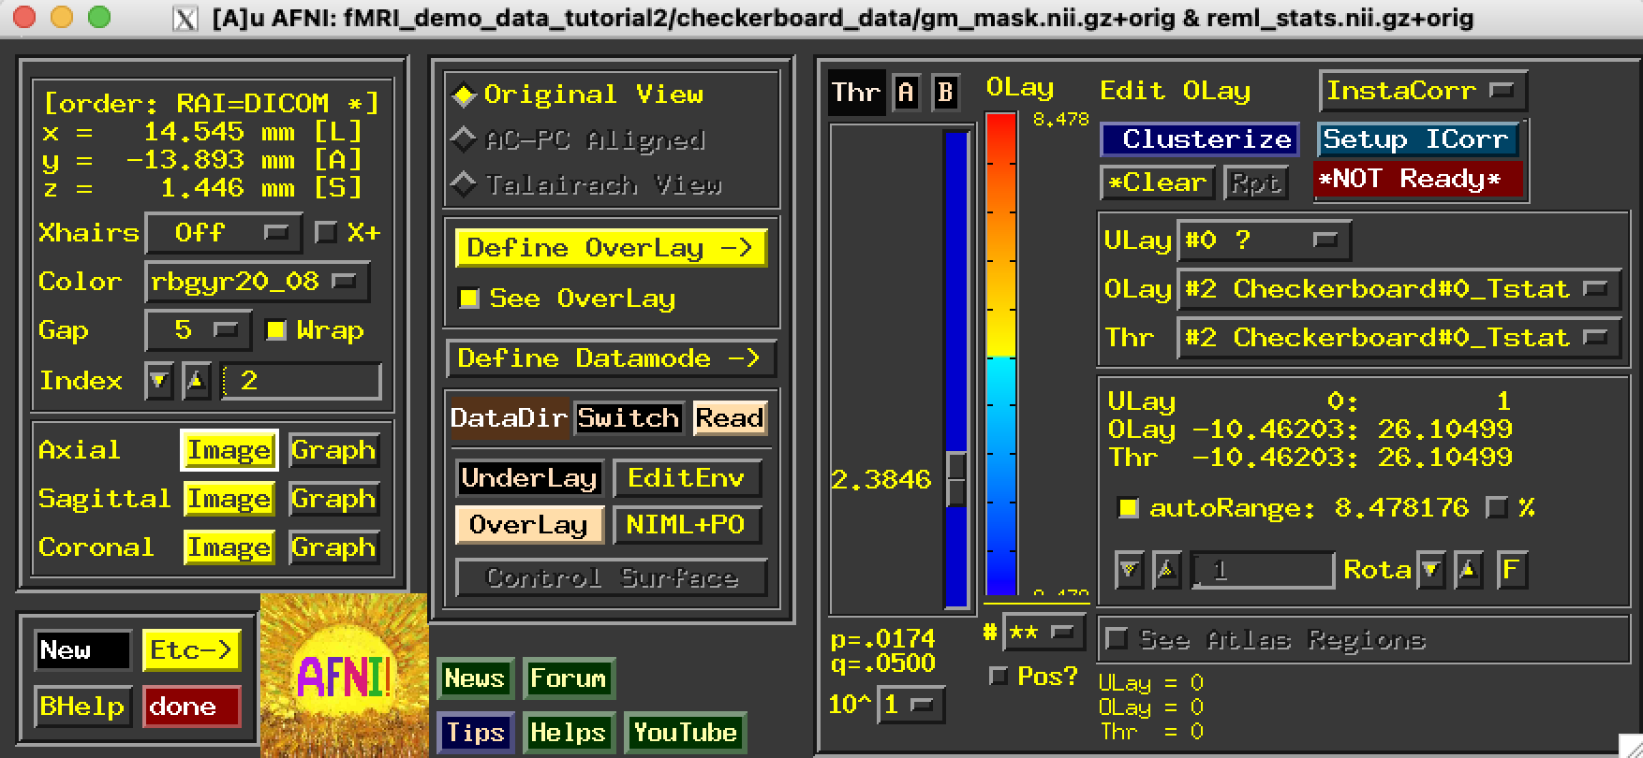
IDEA 3: False Discovery Rate
In AFNI we just have to set our desired q-value and the rest is adjusted for us!
Now we can confidently say that we’ve detected strong activations in the visual cortex!

Slide 34

BREAK TIME

Slide 35
Part IV: DEMO - ICA of Resting State fMRI Data

Slide 36
Step 1: Look at the Preprocessed fMRI Data
This is a 3d+time dataset
It has shape [x,y,z,t]
You can print the header using
3dinfo preprocessed_resting.nii.gz
You can print the acquisition metadata using
cat sub-001_task-rest_run-01_bold.json
I accidentally included the wrong .json in the folder
You can download the correct one from https://openneuro.org/datasets/ds005747/versions/1.2.1

Slide 37
Step 1: Look at the Preprocessed fMRI Data
Data has very high spatial resolution!
1 mm isotropic at 7T
only static images can achieve this resolution at lower fields
TR = 2.34s and we have 256 timepoints thus the acquisition was 599s or approximately 10 minutes long
Similar to the previous dataset, I have already performed motion correction, despiking, spatial smoothing and grey matter masking (somewhat controversial for rs-fMRI)

Slide 38
Step 2: Nuisance Regression
Even though we won’t be running a GLM, we still want to regress out some of the noise that was accounted for in the design matrix.
3dTproject -input preprocessed_resting.nii.gz \
-mask gm_mask.nii.gz \
-bandpass 0.01 0.1 \
-polort 2 \
-ort motion_params.1D
-prefix fmri_cleaned.nii.gz
Notes:
add motion parameters

Slide 39
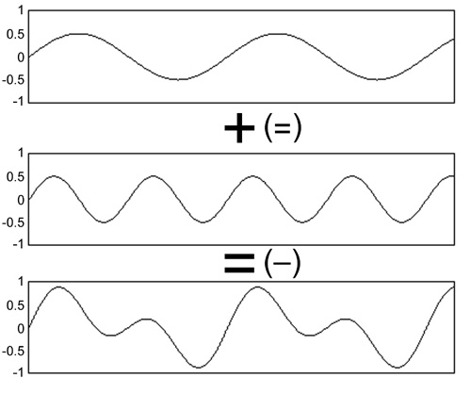
Step 3: Independent Component Analysis
Spatial, model-free approach
Goal: to find interesting structure in the data
A decomposition technique that aims to represent or summarize the data using components (similar conceptually to a Fourier analysis)
Compared to GLM, ICA estimates both the design matrix and parameter estimates
https://musicandcomputersbook.com/chapter3/03_03.php

Slide 40
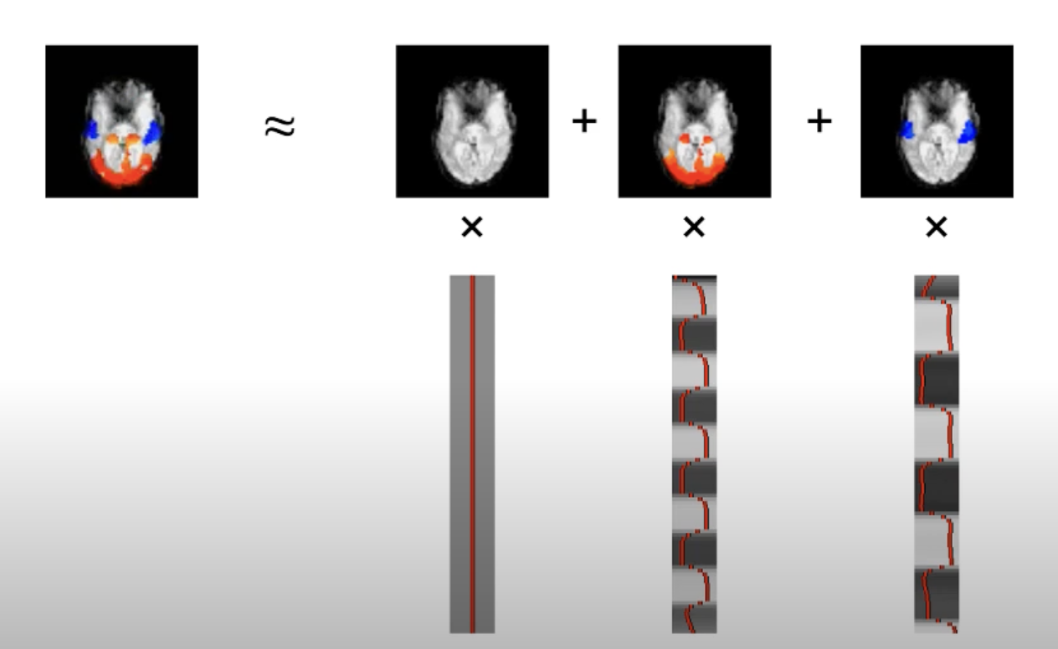
Step 3: Independent Component Analysis
3 components for baseline, visual stimulus and auditory stimulus
FROM FSL Course: https://www.youtube.com/watch?v=RSWuYpjTrk0

Slide 41
Step 3: Independent Component Analysis
melodic –v –i fmri_cleaned.nii.gz –o melodic_resting –-nobet --tr=2.34 --report –d 10
in output directory melodic_resting, image melodic_ICA.nii.gz contains 25 sub-bricks each with an independent spatial component.
Input cleaned timecourses
Name of output directory
Data is already skull-stripped
Number of components to estimate

Slide 42
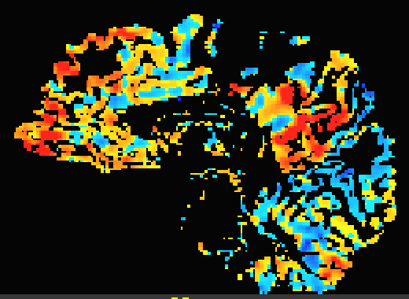
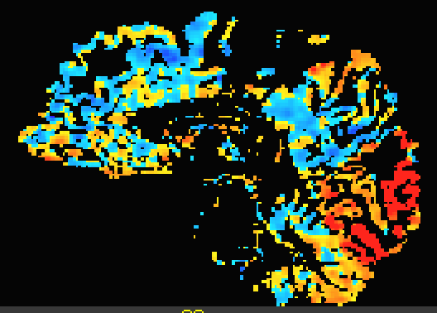
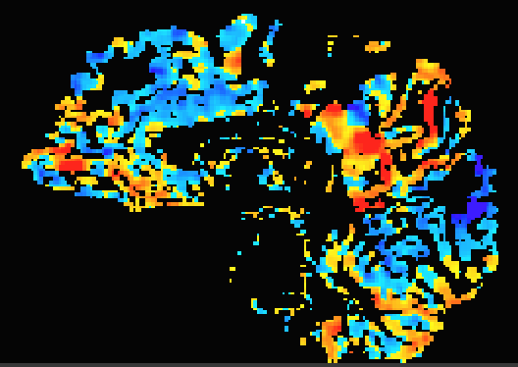
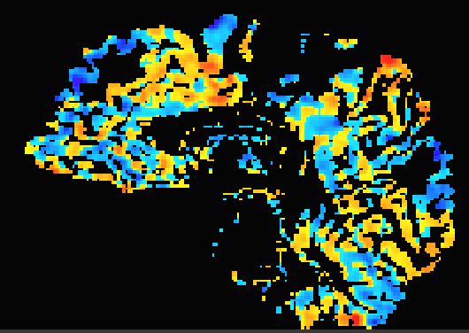
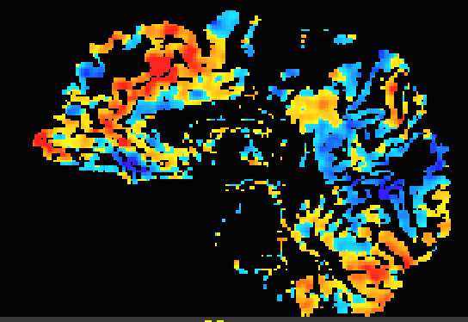
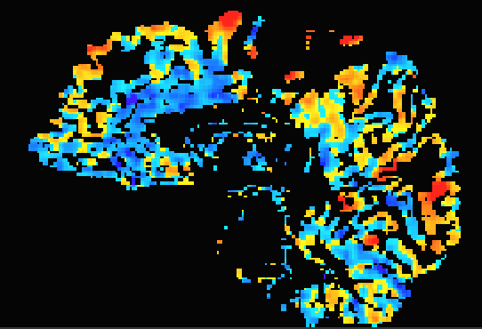
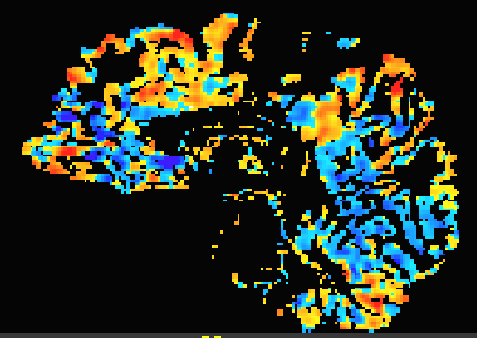
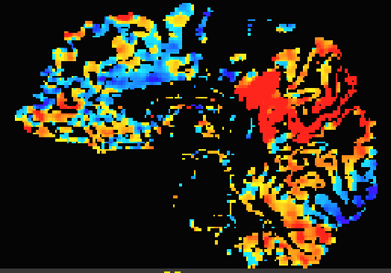
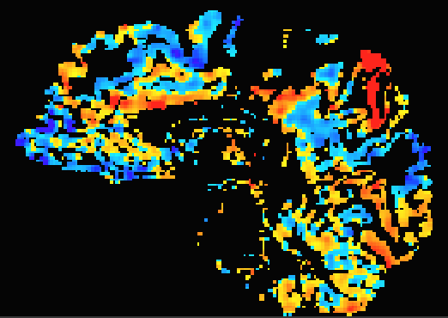
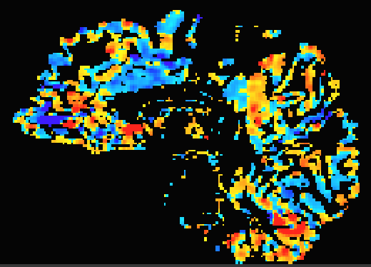
Step 3: Independent Component Analysis
0
Z-score

Slide 43
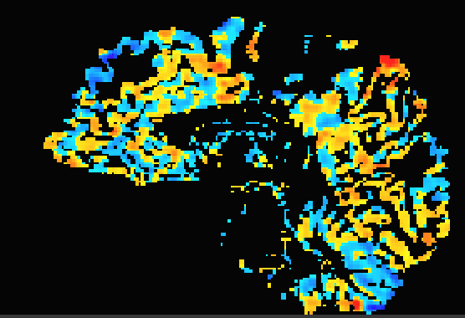
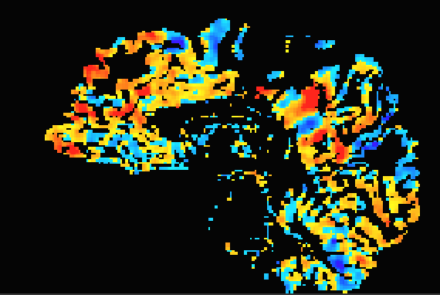
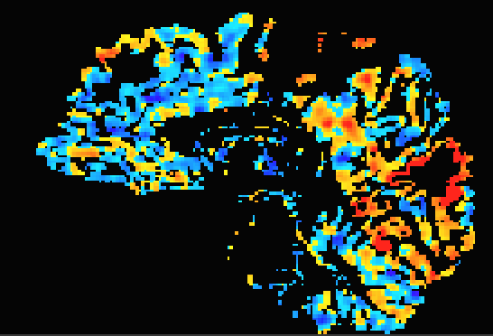
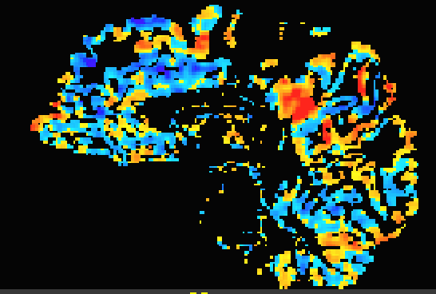
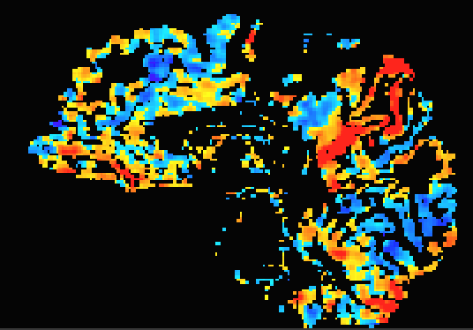
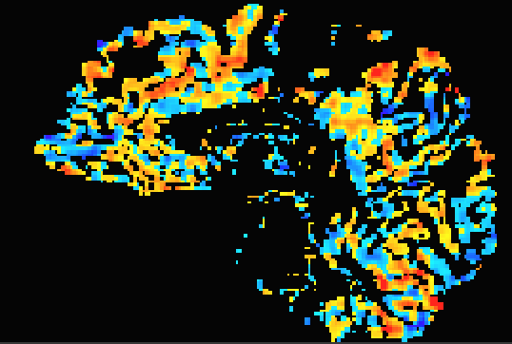
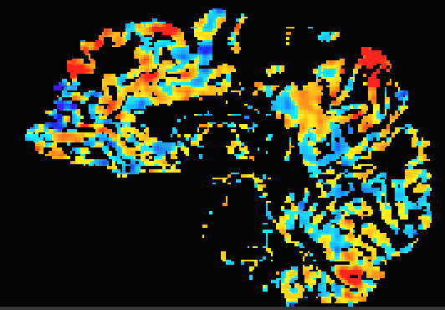


















Step 3: Independent Component Analysis
0
Z-score

Slide 44

Choose # of Components
Less components may “oversimplify” the detected networks
More components can “overfit” and parcellate canonical networks
Common estimates of 8-10 “canonical” brain networks
How to validate the networks detected?

Slide 45
Part V: Other Complexities & Considerations

Slide 46

Network Modelling/Seed Based Approaches
Based on a priori determination of nodes
Temporal approach
Goal: map connections between specific brain regions
Overlay network template and measure how the network “nodes” connect

Slide 47

Network Modelling/Seed Based Approaches
Advantage: simplifies the research question
Limitation: assumes same network topology for all subjects
TLDR: choose your approach based on your research question!!
Gorden et al., Neuron, 2017.

Slide 48
Thank you!😁

Slide 49
References and Further Reading
3dDeconvolve:
https://afni.nimh.nih.gov/pub/dist/doc/program_help/3dDeconvolve.html
https://www.rotman-baycrest.on.ca/index.php?action=download_resource&id=2144&module=resourcesmodule&src=%40random45d093c0ceb64
3dREMLfit:
https://afni.nimh.nih.gov/pub/dist/doc/program_help/3dREMLfit.html
Melodic:
https://web.mit.edu/fsl_v5.0.10/fsl/doc/wiki/MELODIC.html

